Slide 1
Assignment One Outline

Slide 2
What’s due
One academic paper
With a bibliography
Graphs
Uses the outline put forth in week two:
Abstract
Intro
Literary survey
Design of experiments
Discussion of data / results
Conclusion
Questions for future study
bibliography
Each section contributes to the next section, and is indispensable from each other

Slide 3
Grading rubric (how we’ll grade it)
Paper is worth 20% of your final semester grade
8 components, 2.5% per section, equally weighted
For example, 2.5% for a complete bibliography
Or, 2.5% for a complete Introduction
Rely upon class notes, discussions, and examples as the standard

Slide 4
Abstract
Comes last
Do it last
Summarizes everything
Can only be 4 sentences
Label on the soup can – helps others comprehend what you’ve concluded and how
However, the ab appears first, on the front page

Slide 5
Introduction
Layout the purpose of the paper
Write this before you write your abs
Or, you write an intro before you write the rest
Intro is your tool, to help you clarify your mission
Compiles the relevance of your work
You should do several versions of your intro
First intro: should be for you
You’ll need to rewrite this several times
Later versions are for the reader, who must understand the context and import of your work

Slide 6
Literature survey
Provides a huge opportunity to excite and enliven the reader
You must summarize all your readings, with citations
Make sense of the readings, help us understand the strengths and inadequacies of prior work
Contrast what you’re doing in comparison to prior work
Standing on the shoulders of giants, your work entirely depends upon the prior work of others, but you intend to build on top of it
Literature survey is the difference between A & B students
Use your summaries within your literature survey
Literature survey is the most key part because it provides a context for your new information.

Slide 7
DOE: Design of Experiment
DOE is our knowledge tool
It’s a trap: a way to capture data that’s precious to us
Well designed
Questionnaire, sent around via internet, asking folks to detail their experiences
Quantified human experience in our domain well, to arrive at 125 different variations on behavior in regards to stress reduction

Slide 8
Experimental Results Discussion of Data (DOD)
Heart of the paper
Objective: talk about whatever the data says
You don’t need to take sides
No one needs to win; just talk about what the data says
Allow the chips to fall where they may, just tell us what the numbers say
Allow for there to be a clear winner/loser in the numbers

Slide 9
conclusion
After the discussion of data (DOD), everything else is fluff
Intro is basically the same statement as the conclusion, just worded differently
Intro:
We will discuss……
Conclusion:
In this paper, we discussed
Otherwise, it’s the same statement, because
DOD is the heart of the paper
Small conclusions move the world, not big ones

Slide 10
Parting advice
Do each part well
Points are delivered/derived on how well you do each section
Plan to proof read the paper several times
Read it out loud, to locate deficiencies in your style
Check for complimentary consistencies in between sections
->

Slide 11
Complimentary consistencies
Do your intro and conclus say the same thing, and reinforce the message of the paper
Does your LIT SURVEY lead into the design of experiments, which leads to very clear data?

Slide 12
These pieces need to collaborate, work together
LIT SURV
DOE
DOD
The understanding of the reader comes
From reiteration of your key ideas across these
3 sections

Slide 13
LIT SURV
DOE
DOD
If these sections are great, the rest of the paper will be easy

Slide 14
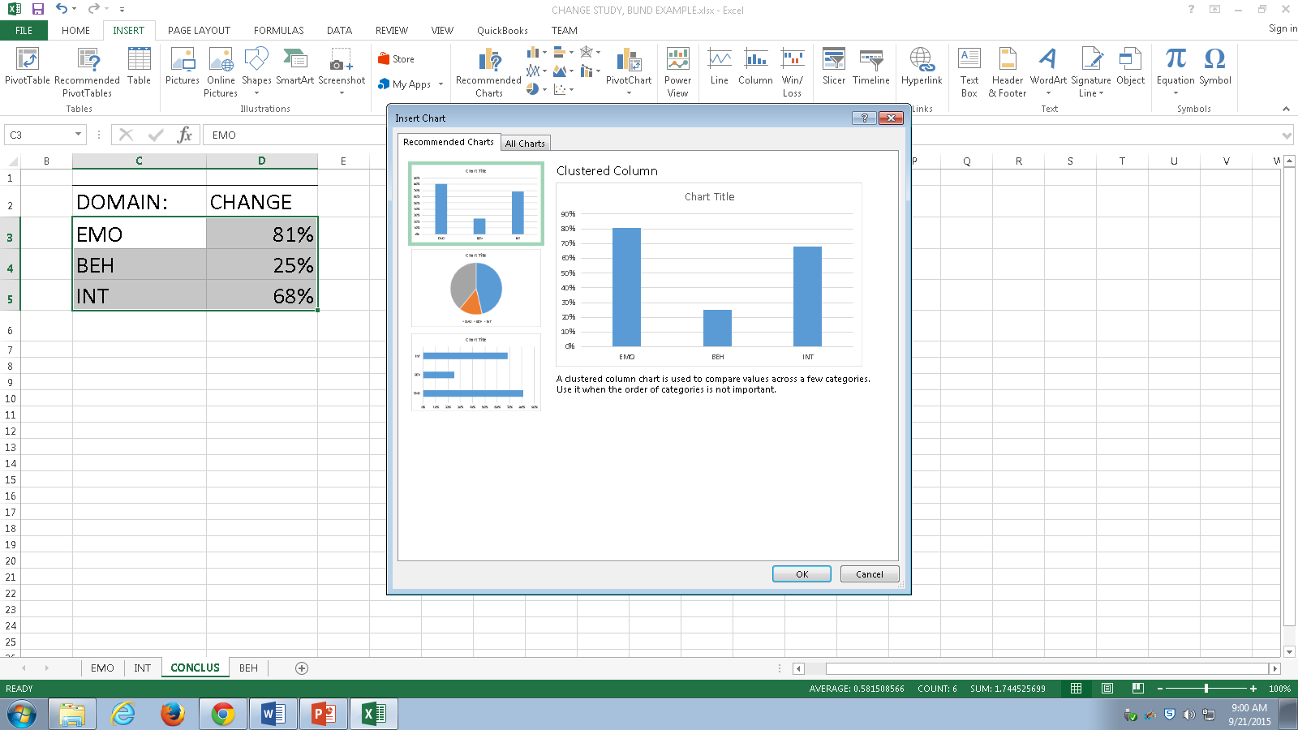
graphing

Slide 15
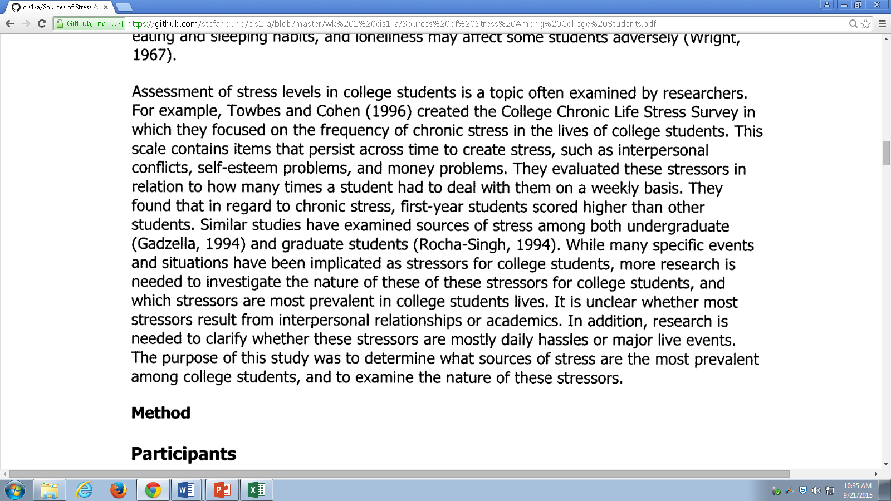
Lit survey
Pattern after the Ross paper
Paraphrase prior work, with a citation

